Slide 1
296.3:Algorithms in the Real World
Convolutional Coding & Viterbi Decoding
296.3
Page<number>

Slide 2
And now a word from my father…
"First, computer software and hardware are the most complex and rapidly developing intellectual creations of modem man."
-- p. iii, Internet and Computer Law, P. B. Maggs, J. T. Soma, and J. A. Sprowl, 2001
296.3
Page<number>

Slide 3
Today’s lecture is based on
A Tutorial on Convolutional Coding with Viterbi Decoding
Chip Fleming
Spectrum Applications
http://home.netcom.com/~chip.f/viterbi/tutorial.html
296.3
Page<number>

Slide 4
Origin of Viterbi Decoding
Andrew J. Viterbi, "Error Bounds for Convolutional Codes and an Asymptotically Optimum Decoding Algorithm," IEEE Transactions on Information Theory, Volume IT-13, pp. 260-269, April 1967.
Viterbi is a founder of Qualcomm.
296.3
Page<number>

Slide 5
Terminology
k number of message symbols (as before)
n number of codeword symbols (as before)
r rate = k/n
m number of encoding cycles an input symbol is stored
K number of input symbols used by encoder to compute each output symbol (decoding time exponentially dependent on K)
296.3
Page<number>

Slide 6
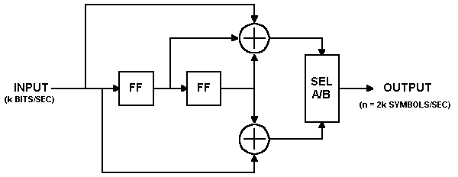
Convolution Encoder
output upper input followed by lower input
flip flop
(stores one bit)
k = 15, n = 30, r = ½, K = 3, m = 2
296.3
Page<number>

Slide 7
Encoding Example
Both flip flops set to 0 initially.
Input: 010111001010001
Output: 00 11 10 00 01 10 01 11 11 10 00 10 11 00 11
Flush encoder by clocking m = 2 times with 0 inputs.
296.3
Page<number>

Slide 8
Viterbi Decoding Applications
decoding trellis-coded modulation in modems
most common FEC technique used in space communications (r = ½, K = 7)
usually implemented as serial concatenated block and convolutional coding – first Reed-Solomon, then convolutional
  because R-S good with burst errors
Turbo codes are a new parallel-concatenated convolutional coding technique
  built around soft-decision Viterbi
296.3
Page<number>

Slide 9
State Transition and Output Tables
 | Next State, if
Current State | Input = 0: | Input = 1:
00 | 00 | 10
01 | 00 | 10
10 | 01 | 11
11 | 01 | 11
 | Output Symbols, if
Current State | Input = 0: | Input = 1:
00 | 00 | 11
01 | 11 | 00
10 | 10 | 01
11 | 01 | 10
State transition table
Output table
2^{m} rows
296.3
Page<number>

Slide 10
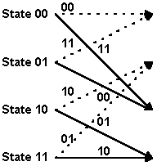
State Transitions
input symbol is 1
input symbol is 0
arcs labeled with output symbols
296.3
Page<number>

Slide 11
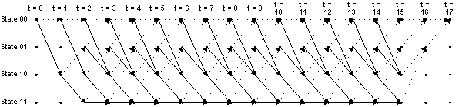
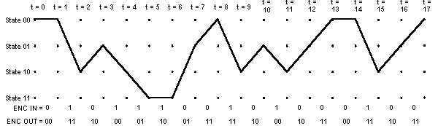
Trellis
296.3
Page<number>

Slide 12
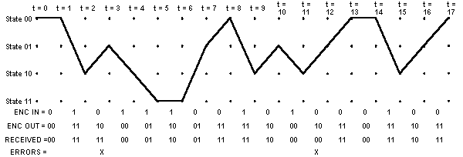
Oh no! Errors in received bits!
296.3
Page<number>

Slide 13
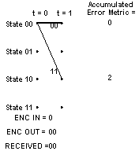
Viterbi Decoding - Accumulated Error Metric
Trying to find the input sequence who corresponding output matches the received output as closely as possible.
(use Hamming distance in our example)
296.3
Page<number>

Slide 14
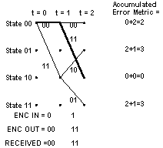
Accumulated Error Metric
296.3
Page<number>

Slide 15
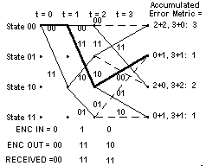
Decoder Trellis
296.3
Page<number>

Slide 16
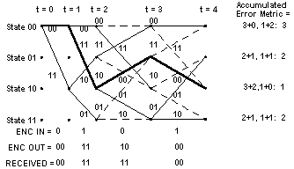
Decoder Trellis
296.3
Page<number>

Slide 17
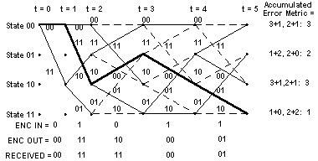
Decoder Trellis
296.3
Page<number>

Slide 18

Final Decoder Trellis
296.3
Page<number>

Slide 19
Accumulated Error Metric over Time
t = | 0 | 1 | 2 | 3 | 4 | 5 | 6 | 7 | 8 | 9 | 10 | 11 | 12 | 13 | 14 | 15 | 16 | 17
State 00₂ |  | 0 | 2 | 3 | 3 | 3 | 3 | 4 | 1 | 3 | 4 | 3 | 3 | 2 | 2 | 4 | 5 | 2
State 01₂ |  |  | 3 | 1 | 2 | 2 | 3 | 1 | 4 | 4 | 1 | 4 | 2 | 3 | 4 | 4 | 2
State 10₂ |  | 2 | 0 | 2 | 1 | 3 | 3 | 4 | 3 | 1 | 4 | 1 | 4 | 3 | 3 | 2
State 11₂ |  |  | 3 | 1 | 2 | 1 | 1 | 3 | 4 | 4 | 3 | 4 | 2 | 3 | 4 | 4
Last two inputs known to be zero.
296.3
Page<number>

Slide 20
Surviving Predecessor States
t = | 0 | 1 | 2 | 3 | 4 | 5 | 6 | 7 | 8 | 9 | 10 | 11 | 12 | 13 | 14 | 15 | 16 | 17
State 00₂ | 00 | 00 | 00 | 01 | 00 | 01 | 01 | 00 | 01 | 00 | 00 | 01 | 00 | 01 | 00 | 00 | 00 | 01
State 01₂ | 00 | 00 | 10 | 10 | 11 | 11 | 10 | 11 | 11 | 10 | 10 | 11 | 10 | 11 | 10 | 10 | 10 | 00
State 10₂ | 00 | 00 | 00 | 00 | 01 | 01 | 01 | 00 | 01 | 00 | 00 | 01 | 01 | 00 | 01 | 00 | 00 | 00
State 11₂ | 00 | 00 | 10 | 10 | 11 | 10 | 11 | 10 | 11 | 10 | 10 | 11 | 10 | 11 | 10 | 10 | 00 | 00
296.3
Page<number>

Slide 21
States Selected when Tracing Back
t = | 0 | 1 | 2 | 3 | 4 | 5 | 6 | 7 | 8 | 9 | 10 | 11 | 12 | 13 | 14 | 15 | 16 | 17
 | 00 | 00 | 10 | 01 | 10 | 11 | 11 | 01 | 00 | 10 | 01 | 10 | 01 | 00 | 00 | 10 | 01 | 00
296.3
Page<number>

Slide 22
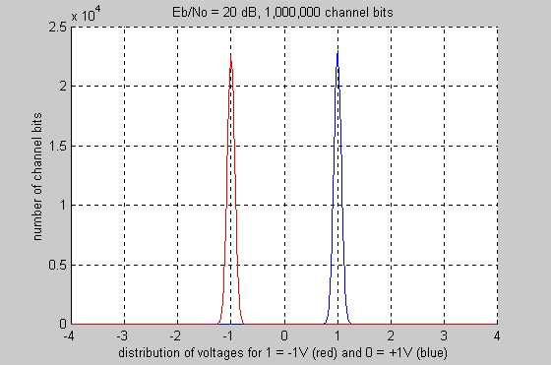
Coding Gain
Transmission voltages (signal to noise ratio SNR 20 dB).
No errors.
296.3
Page<number>

Slide 23
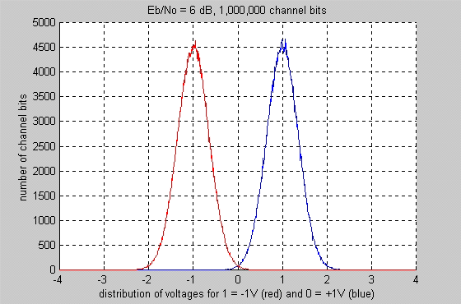
Coding Gain
Transmission voltages with Gaussian noise (SNR 6dB)
bit error rate (BER) of about 0.235%
296.3
Page<number>

Slide 24
Coding Gain
convolutional coding with Viterbi decoding can achieve a BER of less than 1 x 10⁻⁷ at the same SNR, 6 dB
r = ½, K = 3
Use 5db less power to achieve 1 x 10⁻⁷ BER than without coding
Coding uses twice as much (3dB) bandwidth
Coding gain: 5dB-3dB = 2dB less energy
296.3
Page<number>

Slide 25
References (from Fleming)
Some Books about Forward Error Correction
S. Lin and D. J. Costello, Error Control Coding. Englewood Cliffs, NJ: Prentice Hall, 1982.
A. M. Michelson and A. H. Levesque, Error Control Techniques for Digital Communication. New York: John Wiley & Sons, 1985.
W. W. Peterson and E. J. Weldon, Jr., Error Correcting Codes, 2 nd ed. Cambridge, MA: The MIT Press, 1972.
V. Pless, Introduction to the Theory of Error-Correcting Codes, 3rd ed. New York: John Wiley & Sons, 1998.
C. Schlegel and L. Perez, Trellis Coding. Piscataway, NJ: IEEE Press, 1997
S. B. Wicker, Error Control Systems for Digital Communication and Storage . Englewood Cliffs, NJ: Prentice Hall, 1995.
296.3
Page<number>

Slide 26
More References (from Fleming)
Some Papers about Convolutional Coding with Viterbi Decoding
For those interested in VLSI implementations of the Viterbi algorithm, I recommend the following paper and the papers to which it refers (and so on):
Lin, Ming-Bo, "New Path History Management Circuits for Viterbi Decoders," IEEE Transactions on Communications, vol. 48, October, 2000, pp. 1605-1608.
Other papers are:
G. D. Forney, Jr., "Convolutional Codes II: Maximum-Likelihood Decoding," Information Control, vol. 25, June, 1974, pp. 222-226.
K. S. Gilhousen et. al., "Coding Systems Study for High Data Rate Telemetry Links," Final Contract Report, N71-27786, Contract No. NAS2-6024, Linkabit Corporation, La Jolla, CA, 1971.
J. A. Heller and I. M. Jacobs, Viterbi Decoding for Satellite and Space Communications," IEEE Transactions on Communication Technology, vol. COM-19, October, 1971, pp. 835-848.
K. J. Larsen, "Short Convolutional Codes with Maximal Free Distance for Rates 1/2, 1/3, and 1/4," IEEE Transactions on Information Theory, vol. IT-19, May, 1973, pp. 371-372.
J. P. Odenwalder, "Optimum Decoding of Convolutional Codes," Ph. D. Dissertation, Department of Systems Sciences, School of Engineering and Applied Sciences, University of California at Los Angeles, 1970.
A. J. Viterbi, "Error Bounds for Convolutional Codes and an Asymptotically Optimum Decoding Algorithm," IEEE Transactions on Information Theory , vol. IT-13, April, 1967, pp. 260-269.
296.3
Page<number>

